Slide 1
Coordination and Brain Activity Correlates of Upper-Limb Prosthesis Use
James Pierce
May 17, 2018

Slide 2
Agenda
Introduction
Statement of the Problem
Background Information
Methodology
Results
Discussion

Slide 3
Introduction
The Centers for Disease Control and Prevention (CDC) estimate that about 1,500 children are born with upper limb deficiencies (ULDs) every year
Only 1 in 9,400 children with ULDs are considered for prosthetic fitting due to:
Rapid growth
High prosthesis cost
Inadequate device functionality
Of those that receive a prosthesis, there is also a high rate of device abandonment
It has been proposed that ULDs can lead to Quality of Life detriments such as:
Delayed or absent developmental milestones
Mobility and self-care limitations

Slide 4
Introduction
Early age fitting and prosthesis use have been suggested to aid motor development and function
Prevalence of ULDs is too low to create high power studies determining the true value of early prosthesis fitting
Prosthesis simulators could be one option to improve the design/functionality and prescription of devices despite the small population of pediatric amputees
Much larger pool of research subjects can be made available
Amateur prosthesis conditions can be tested more easily

Slide 5
Agenda
Introduction
Statement of the Problem
Background Information
Methodology
Results
Discussion

Slide 6
Purpose
To determine the influence of upper-limb prostheses and prosthetic simulators (compared to typically developing control children) on:
Bimanual coordination
Gross manual dexterity

Slide 7
Aims/Hypotheses
Specific Aim 1: Determine differences in coordination among upper-limb prosthesis, prosthetic simulator, and typically developing control groups during performance of a bimanual coordination task.
Hypothesis 1a: Bimanual coordination will be significantly higher in the control group than prosthesis and simulator groups.
Hypothesis 1b: Coordination deficits in the prosthesis group will lessen with repeated prosthesis use.
Specific Aim 2: Determine differences in motor function among upper-limb prosthesis, prosthetic simulator, and typically developing control groups during performance of a gross manual dexterity task.
Hypothesis 2: Prosthesis users will perform similarly to subjects using a prosthesis simulator.

Slide 8
Agenda
Introduction
Statement of the Problem
Background Information
Methodology
Results
Discussion

Slide 9
Background Information
Quality of Life:
Qualitative measurement tools indicate limited usefulness of prostheses as rehabilitative tools
Functionality is only significantly improved for specialized activities
Quantitative measures show potential improvements overlooked by qualitative measures
Improvements in dexterity, tactile sensation, coordinated motions of the hand, and proprioceptive feedback have been observed
Coordination:
Somatosensory deficits lead to differences in interlimb coordination
Spinal cord injury and deafferentation negatively impact coordinated and cognitively demanding motions
Handedness can cause temporal coordination deficiencies in cognitively demanding tasks
Viability of Prosthetic Simulators:
Simulators have been shown to produce similar learning effects to novice amputees
These devices can improve the power of studies performed with prostheses

Slide 10
Agenda
Introduction
Statement of the Problem
Background Information
Methodology
Results
Discussion

Slide 11
Methodology: Participants
Three subject conditions:
Unilateral upper-limb deficiencies (ULD, n = 5)
Typically developing group using a prosthesis simulator (Simulator, n = 5)
Typically developing control children (Control, n = 5)
Inclusion Criteria:
Aged 3-16 years with unilateral upper-limb congenital reductions of any digit, hand, arm, or shoulder
Any subjects with prior prosthesis experience must cease usage for at least six months prior to the study

Slide 12
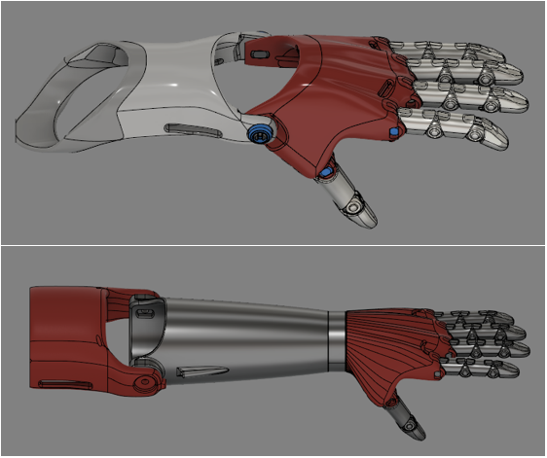
Methodology: Apparatus/Materials
Prosthetic Device/Simulator:
Body-powered, manually adjustable and produced primarily using 3D printers
Aids in the performance of bimanual and unilateral activities with a functional grasp
Voluntary-Close (VC) in grip style
Custom scaled and fitted to a specialized socket

Slide 13
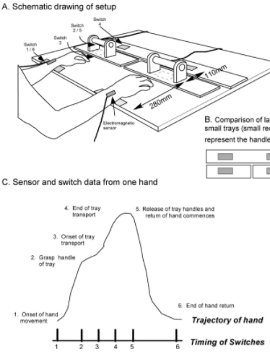
Methodology: Bimanual Coordination
Instrumented reaching tray to assess temporal coordination during reaching tasks
Relative timing for each component of task motion was recorded for both unimanual and bimanual conditions
Quantifies relative phase differences between prosthesis users, simulator users and typically developing controls
Kilbreath SL, Crosbie J, Canning CG, Lee MJ. Inter-limb coordination in bimanual reach-to-grasp following stroke. Disability and Rehabilitation. 2009:1435.

Slide 14
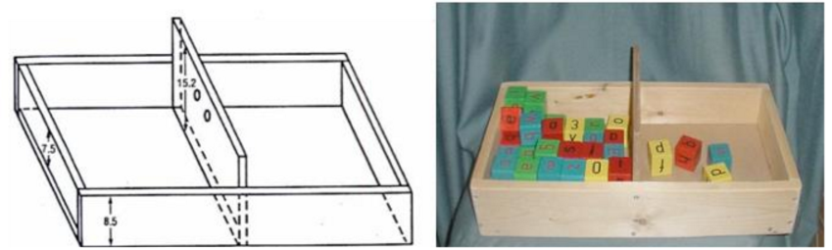
Methodology: Gross Manual Dexterity
“Box and Block” test as a measure of unilateral upper limb gross dexterity
Small, partitioned box filled with identical blocks
Number of blocks transferred between partitioned areas of the box is used as a measure of motor function
Testing takes place over 1 minute, and is repeated to ensure reliability of results
Task is performed for both preferred and non-preferred hands
Do EY, Hsiao C, Zhao C. The digital box and block test automating traditional post-stroke rehabilitation assessment. PerCom Workshop. 2013.

Slide 15
Agenda
Introduction
Statement of the Problem
Background Information
Methodology
Results
Discussion

Slide 16
Results: Movement Synchrony
Prosthesis/simulator users had higher movement asynchrony than controls
Prosthesis users adopt different task strategies than simulator users
Leading with non-affected hand for task completion
Indicates potential bimanual coordination deficits
Overall Task Time
 | Preferred Hand | Non-Preferred Hand
Prosthesis | 9.442 ± 3.688s | 10.828 ± 5.013s
Prosthesis Simulator | 6.061 ± 2.657s | 6.421 ± 2.778s
Control | 2.102 ± 1.179s | 2.216 ± 1.306s

Slide 17
Results: Motor Learning
One month of use shows improved bimanual movement synchrony
Prosthesis user task strategy at one month follows the same trends as control subjects at baseline testing
Could indicate adoption of more optimal motor control strategies
Demonstrates functional learning, which could impact quality of life

Slide 18
Results: Gross Manual Dexterity
No significant differences in task performance between prosthesis and simulator users
Suggests that prosthesis simulators are good functional approximations of amputee performance
Allows for prosthesis development/improvement, optimization and testing before involving amputee subjects
Helps to isolate influence of prosthesis from underlying deficits
Task Performance (Blocks Transferred)
 | Preferred Hand | Non-Preferred Hand
Prosthesis | 37.40 ± 6.65 | 7.23 ± 3.37
Prosthesis Simulator | 47.60 ± 17.31 | 7.63 ± 5.61
Control | 47.60 ± 17.31 | 49.43 ± 15.21

Slide 19
Agenda
Introduction
Statement of the Problem
Background Information
Methodology
Results
Discussion

Slide 20
Discussion
Potential coordination deficits observed in bimanual reaching could indicate reduced function earlier in life than has been previously assumed
Movement synchrony during bimanual tasks is improved through practice with the prostheses
Timing patterns of the movement, which are similar to control subjects, may indicate the learning and adoption of a more optimal task strategy
Lack of significant differences between simulator and prosthesis users could indicate that prosthetic simulators are effective surrogates for amputees
Can potentially improve statistical power and enhance iterative device design

Slide 21
Possible Limitations
Experiment Limitations:
Subject pool for ULDs is small, and many have used prostheses before
Limited number of subjects restricts study population size
Prior prosthesis users are accounted for with minimum 6 month abandonment of prior prosthetic
Pediatric population limits the number of feasible trials
Large range of subject ages and levels of amputation

Slide 22
Questions/Suggestions?

Slide 23
References
Krebs D, Edelstein J, Thornby M. Prosthetic management of children with limb deficiencies. Physical Therapy. 1991;71(12):920.
Hadders-Algra M. The neuronal group selection theory: A framework to explain variation in normal motor development. Dev Med Child Neurol. 2000;42(8):566-572. doi: 10.1017/S0012162200001067.
Hadders-Algra M M. The neuronal group selection theory: Promising principles for understanding and treating developmental motor disorders. Dev Med Child Neurol. 2000-10;42(10):707-15.
Facts about upper and lower limb reduction defects. . 2016.
About ABS - amniotic constriction band syndrome. (n.d.).
James MA, Bagley AM, Brasington K, Lutz C, McConnell S, Molitor F. Impact of prostheses on function and quality of life for children with unilateral congenital below-the-elbow deficiency. J Bone Joint Surg Am. 2006;88(11):2356-2365.
Meurs M, Maathuis CG, Lucas C, Hadders-Algra M, van der Sluis CK. Prescription of the first prosthesis and later use in children with congenital unilateral upper limb deficiency: A systematic review. Prosthetics and Orthotics International. 2006;30(2):165-173.
Huizing K, Reinders-Messelink H, Maathuis C, Hadders-Algra M, van der Sluis CK. Age at first prosthetic fitting and later functional outcome in children and young adults with unilateral congenital below-elbow deficiency: A cross-sectional study. Prosthetics and orthotics international. 2010;34(2):166-174.
Zuniga JM, Pierce III JE, Than N, et al. Function of a 3D printed transitional prosthesis. . 2017.
Do EY, Hsiao C, Zhao C. The digital box and block test automating traditional post-stroke rehabilitation assessment. PerCom Workshop. 2013.
Korkmaz M, Erbahceci F, Ulger O. Evaluation of functionality in acquired and congenital upper extremity child amputees. Acta Orthop Traumatol Turc. 2012;46:262-268.

Slide 24
References
Dromerick A, Schabowsky C, Holley R, Monroe B, Markotic A, Lum P. Effect of training on upper-extremity prosthetic performance and motor learning: A single-case study. Arch Phys Med Rehabil. 2008;89:1199.
Tihanyi J. Body schema and body awareness of amputees. . Prosthetics and Orthotics International. 2008;32:363-382.
Imaizumi S, Asai T, Koyama S. Embodied prosthetic arm stabilizes body posture, while unembodied one perturbs it. Consciousness and Cognition. 2016;45(Supplement C):75-88. doi: https://doi.org/10.1016/j.concog.2016.08.019.
Sporns O, Edelman GM. Solving bernstein's problem: A proposal for the development of coordinated movement by selection. Child Development. 1993;64:960-981.
Polovina S, Škorić Polovina T, Polovina A, Polovina-Prološčić T. Intensive rehabilitation in children with cerebral palsy: Our view on the neuronal group selection theory. Collegium antropologicum. 2010;34(3):981-988.
Valk TA, Mouton LJ, Bongers RM. Joint-angle coordination patterns ensure stabilization of a body-plus-tool system in point-to-point movements with a rod. Frontiers in psychology. 2016;7:826.
Huinink LHB, Bouwsema H, Plettenburg DH, van der Sluis CK, Bongers RM. Learning to use a body-powered prosthesis: Changes in functionality and kinematics. Journal of NeuroEngineering and Rehabilitation. 2016;13(1):90. https://doi.org/10.1186/s12984-016-0197-7. Accessed 9/12/2017 1:16:10 PM.
Weeks DL, Wallace SA, Anderson DI. Training with an upper-limb prosthetic simulator to enhance transfer of skill across limbs. Arch Phys Med Rehabil. 2003;84. https://doi.org/10.1053/apmr.2003.50014. Accessed 9/12/2017 1:16:10 PM.
Weeks DL, Anderson DI, Wallace SA. The role of variability in practice structure when learning to use an upper-extremity prosthesis. J Prosthet Orthot. 2003;15. https://doi.org/10.1097/00008526-200307000-00006. Accessed 9/12/2017 1:16:10 PM.
Field-Fote EC, Tepavac D. Improved intralimb coordination in people with incomplete spinal cord injury following training with body weight support and electrical stimulation. Physical Therapy. 2002;82(7):707-715.
Huinink LHB, Bouwsema H, Plettenburg DH, van dS, Bongers RM. Learning to use a body-powered prosthesis: Changes in functionality and kinematics. Journal of NeuroEngineering and Rehabilitation. 2016;13(1):90. https://doi.org/10.1186/s12984-016-0197-7. doi: 10.1186/s12984-016-0197-7.

Slide 25
References
Kilbreath SL, Crosbie J, Canning CG, Lee MJ. Inter-limb coordination in bimanual reach-to-grasp following stroke. Disability and Rehabilitation. 2009:1435.
Nishiyori R, Bisconti S, Ulrich B. Motor cortex activity during functional motor skills: An fNIRS study. Brain topography. 2016;29(1):42-55.
Semjen A. Bimanual coordination during rhythmic movements in the absence of somatosensory feedback. . 2005;94.
Tian F, Delgado MR, Dhamne SC, et al. Quantification of functional near infrared spectroscopy to assess cortical reorganization in children with cerebral palsy. Opt.Express. 2010;18(25):25973-25986. http://www.opticsexpress.org/abstract.cfm?URI=oe-18-25-25973. doi: 10.1364/OE.18.025973.
Giele H, Giele C, Bower C, Allison M. The incidence and epidemiology of congenital upper limb anomalies: A total population study. The journal of hand surgery. 2001;26(4):628-634.
Canfield MA, Honein MA, Yuskiv N. National estimates and race/ethnic-specific variation of selected birth defects in the united states, 1999-2001. Birth defects research. Part A, Clinical and molecular teratology. 2006;76(11):747-756.
Resnik L, Meucci MR, Lieberman-Klinger S. Advanced upper limb prosthetic devices: Implications for upper limb prosthetic rehabilitation. Arch Phys Med Rehabil. 2012;93(4):710-717.
Resnik L. Development and testing of new upper-limb prosthetic devices: Research designs for usability testing. Journal of rehabilitation research and development. 2011;48(6):697-706.
Hadders-Algra M, Reinders-Messelink HA, Huizing K, van den Berg R, van der Sluis CK, Maathuis CGB. Use and functioning of the affected limb in children with unilateral congenital below-elbow deficiency during infancy and preschool age: A longitudinal observational multiple case study. Early Human Development. 2013;89(1):49-54. doi: https://doi.org/10.1016/j.earlhumdev.2012.07.011.
Biddiss EA, Chau TT. Upper limb prosthesis use and abandonment: A survey of the last 25 years. Prosthet Orthot Int. 2007;31. https://doi.org/10.1080/03093640600994581. Accessed 9/12/2017 1:16:10 PM.
Zuniga JM, Carson AM, Peck JM, Kalina T, Srivastava RM, Peck K. The development of a low-cost three-dimensional printed shoulder, arm, and hand prostheses for children. Prosthetics and Orthotics International. 2016.

Slide 26
References
Zuniga JM, Katsavelis D, Peck JM. Cyborg beast: A low-cost 3d-printed prosthetic hand for children with upper-limb differences. BMC research notes. 2015;8(1):10.
Zuniga JM, Peck J, Srivastava R, Katsavelis D, Carson A. An open source 3D-printed transitional hand prosthesis for children. JPO: Journal of Prosthetics and Orthotics. 2016;28(3):103-108.
Rajak BL, Gupta M, Bhatia D. Growth and advancements in neural control of limb. Biomedical Science and Engineering. 2015;3(3):46-64.
Nishiyori R. fNIRS: An emergent method to document functional cortical activity during infant movements. Frontiers in psychology. 2016;7:533.
Mathiowetz V, Wiemer D, Federman S. Grip and pinch strength: Norms for 6- to 19-year-olds. The American journal of occupational therapy. 1986;40(10):705-711.
Petersson C, Simeonsson RJ, Enskar K, Huus K. Comparing children's self-report instruments for health-related quality of life using the international classification of functioning, disability and health for children and youth (ICF- CY). Health and quality of life outcomes. 2013;11(75).
Reilly KT, Sirigu A. Motor cortex representation of the upper-limb in individuals born without a hand. PLoS One. 2011;6(4).
Shirota C, Jansa J, Diaz J, et al. On the assessment of coordination between upper extremities: Towards a common language between rehabilitation engineers, clinicians and neuroscientists. Journal of NeuroEngineering and Rehabilitation. 2016;13(1):80.
Burgess Limerick R, Abernethy B, Neal RJ. Relative phase quantifies interjoint coordination. Journal of biomechanics. 1993;26(1):91-94.
Franz EA, Rowse A, Ballantine B. Does handedness determine which hand leads in a bimanual task? Journal of Motor Behavior. 2002;34(4):402-412.

